Slide 1
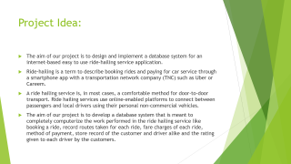
RIDE HAILING SYSTEM
END SEMESTER PROJECT

Slide 2
Members:
Sabayna Ali
Immad amir

Slide 3
Project Idea:
The aim of our project is to design and implement a database system for an internet-based easy to use ride-hailing service application.
Ride-hailing is a term to describe booking rides and paying for car service through a smartphone app with a transportation network company (TNC) such as Uber or Careem.
A ride hailing service is, in most cases, a comfortable method for door-to-door transport. Ride hailing services use online-enabled platforms to connect between passengers and local drivers using their personal non-commercial vehicles.
The aim of our project is to develop a database system that is meant to completely computerize the work performed in the ride hailing service like booking a ride, record routes taken for each ride, fare charges of each ride, method of payment, store record of the customer and driver alike and the rating given to each driver by the customers.

Slide 4
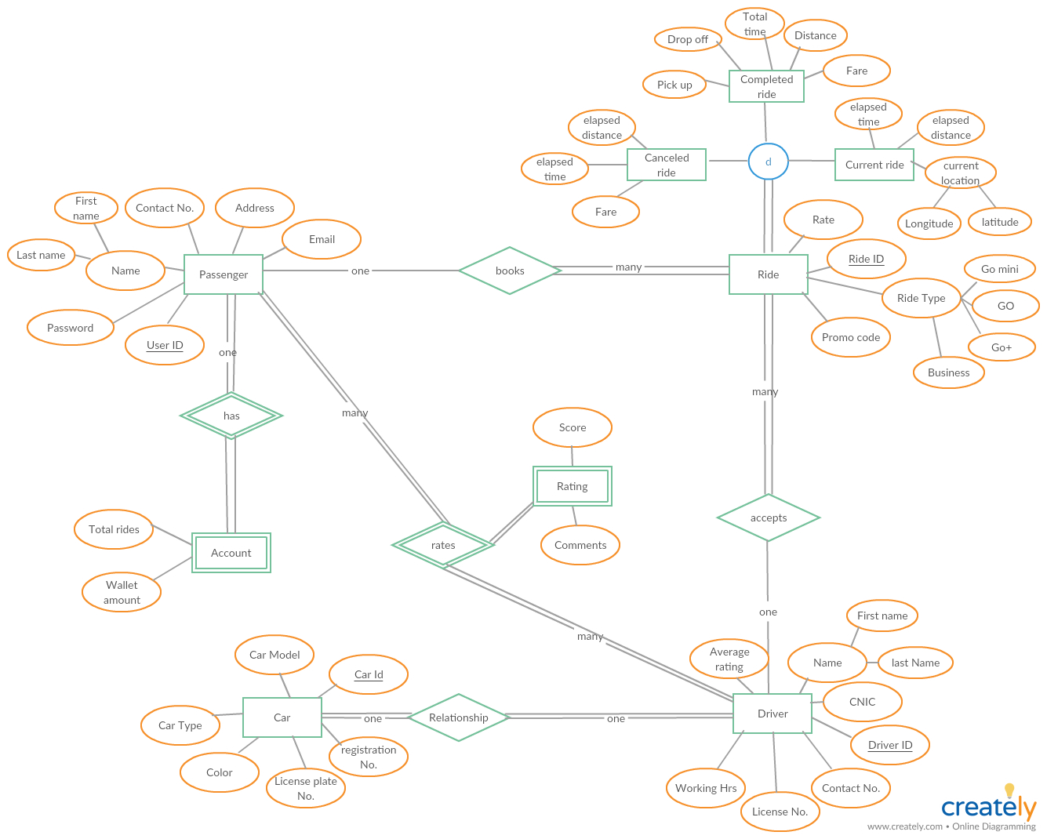
Entity Relationship Diagram:

Slide 5
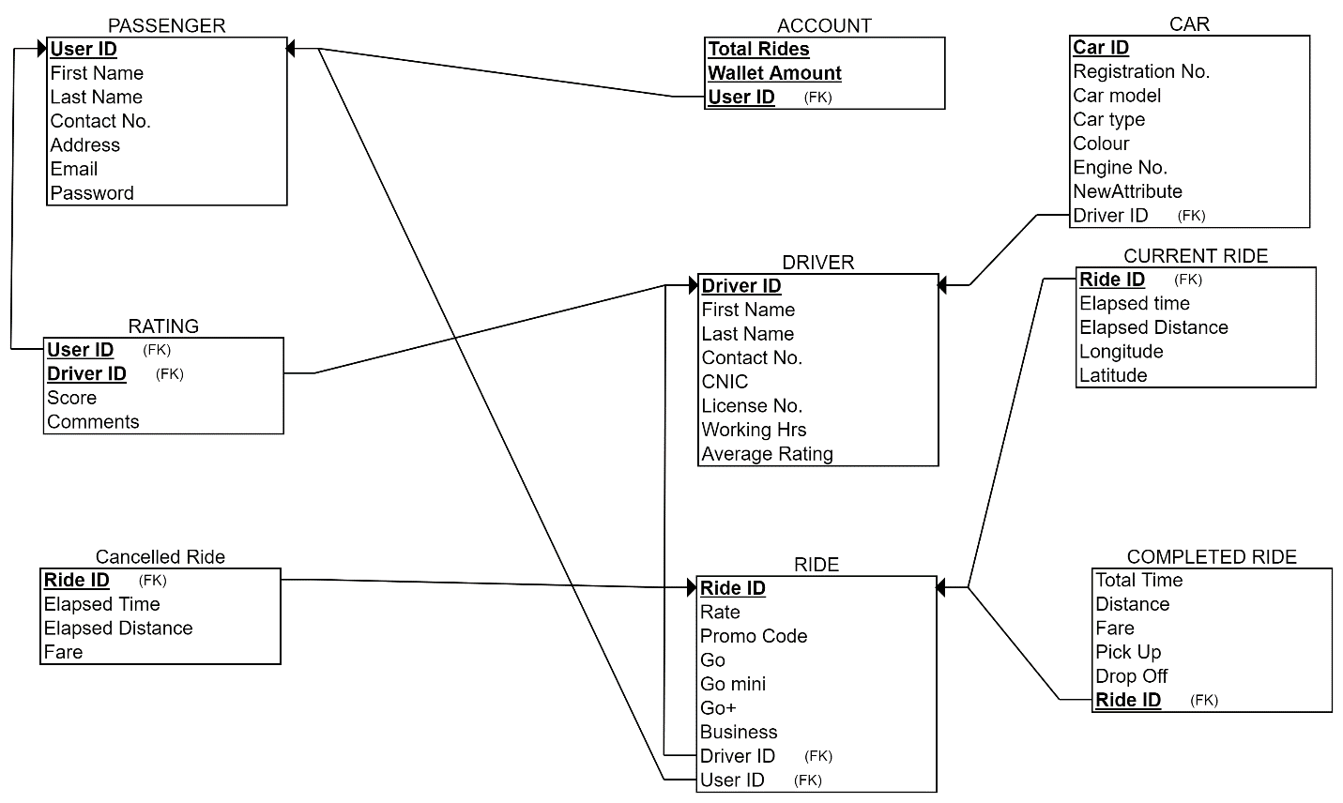
Schema:

Slide 6
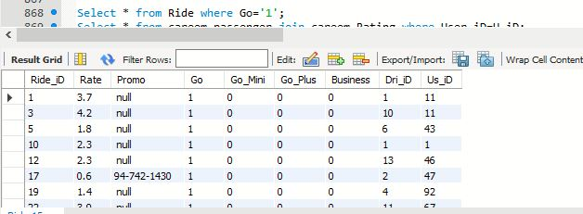
Implementation

Slide 7
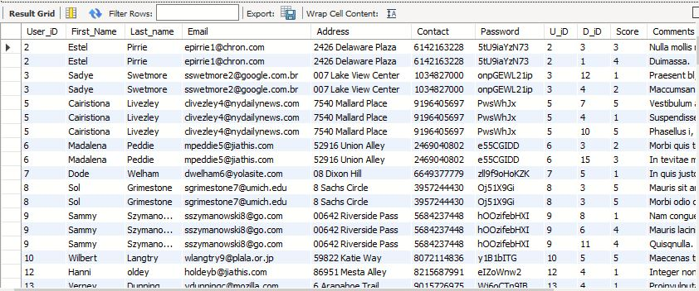
Query 2

Slide 8
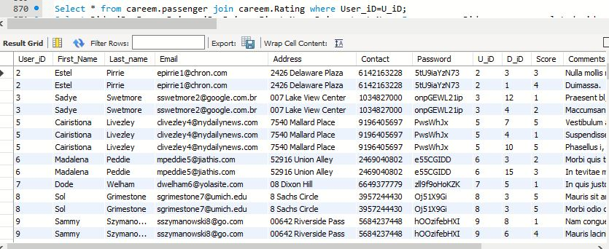
Query 3

Slide 9
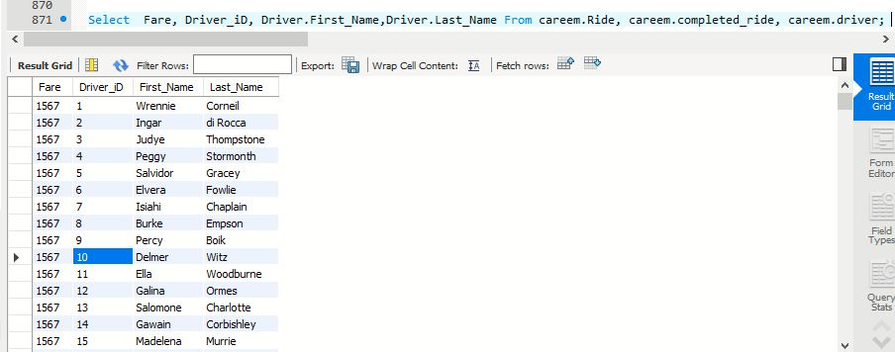
Query 4

